Slide 1

Where is the Black Homeownership Gap Narrowing in the U.S.?
Andrew Warren
May 13, 2021

Slide 2
Motivation
A huge portion of the nation’s net worth comes from homeownership (especially if you’re not super rich).
~71% of white families own homes vs. ~42% of Black families.*
Are certain places in the U.S. closing this gap? What might they have in common?
* ”A closer look at the fifteen-year drop in black homeownership,” Goodman et al, The Urban Institute, 2018

Slide 3
Data
EVERY mortgage application (almost)
Race
Census Tract
An API
Notes:
HMDA API: a record for every home loan application in the U.S. (almost)
Includes race of applicant, census tract of the home, outcome and purpose of the application.
Created a dataset for each state in the U.S. that summarizes these attributes by county, merged it with census data by county.

Slide 4
Measure of Interest: “Black Home Purchase Ratio”
By County:
New Home Purchases
to Black People
Black New Purchase %
Total Home Purchases
Black Pop. %
Black Population
Total Population
Intuition:
This should be ~ 1 in an equitable world.
If it’s close to 1 or greater, the racial homeownership gap is probably closing in that area (depending on current gap.)

Slide 5
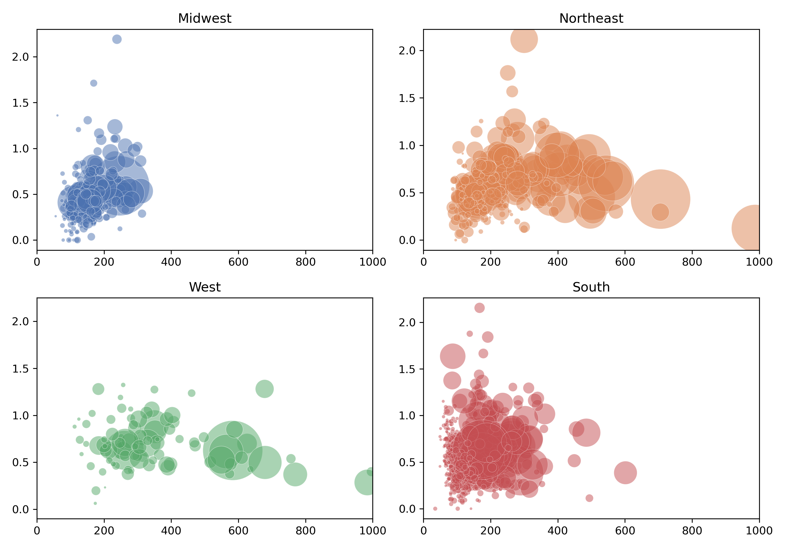
Black Mortgage Ratios by Census Region, 2019
Wright, MN
Bristol, MA
Litchfield, CT
Hancock, IN
Warren, NJ
Anoka, MN
Black Home Purchase Ratio
Livingston Parish, LA
Ellis, TX
Pinal, AZ
San Joaquin, CA
Honolulu, HI
Hidalgo, TX
Median Home Value (Thousands of Dollars)
Note: bubble size is proportionate to county population.
Notes:
You can run my scripts for any combination of states and years, and add any ACS variables you like.
Here’s an example of what you can do with 2019 data across all fifty states.
Each plot is a census region, each bubble is a county, and the size of the bubble is the county’s population.
The ratio measure of new Black homes is on the y-axis, and median home value is on the x-axis.
You can see pretty different relationships between home value and black home purchase ratio by region.
And in case you’re curious, here are some of the counties that have the highest ratios in each region.
I think the cool innovation of this project is that you can throw almost any ACS variable you want on the x-axis here. And you could also do much deeper analysis by running my script for multiple years, which would allow you essentially create a longitudinal data.

